Slide 1
Need for Object-Oriented
Systems Development
CSA1109-OBJECT-ORIENTED ANALYSIS & DESIGN
PRESENTED BY:
ASHMI P S(192571004)

Slide 2
Limits of the Traditional Approach
Traditional development treats a program as a sequence of steps (functions) that read and modify data stored separately from those functions.
Data and functions are kept apart — any function can freely read or change shared data, with nothing to guard it.
The same logic gets rewritten in multiple places instead of being reused.
A change made in one part of the program can silently break an unrelated part.
Code structure doesn’t map naturally to the real-world things it’s meant to represent (customers, accounts, orders)

Slide 3
Software Outgrew the Old Approach
Larger
Longer-lived
Less stable
Applications grew from small scripts to millions of lines built by large teams.
Systems stayed in use and kept changing for years, not just one release.
Business requirements kept shifting after deployment, demanding constant rework.
The result
With shared, unprotected data and duplicated logic, bugs became harder to isolate — more code was touching the same data, so a fix in one place could quietly create a problem somewhere else.

Slide 4
What Development Really Needed
1
Manage complexity
Break large systems into smaller, self-contained units
2
Model the real world
Represent real entities customers, orders, accounts directly in code
3
Protect data
Control who can see or change an object’s internal data
4
Reuse proven code
Build new features from existing components instead of rewriting
5
Adapt without breaking things
Extend or change behavior without disturbing code that already works

Slide 5
How Object Orientation Meets These Needs
Need | OO Concept | What It Does
Manage complexity | Objects & Classes | Bundle data and behavior into self-contained units
Model the real world | Classes | Represent real entities with attributes and methods
Protect data | Encapsulation | Hides internal data behind a controlled interface
Reuse proven code | Inheritance | New classes build on existing ones instead of starting over
Adapt safely | Polymorphism & Relationships | Let objects extend or connect without breaking existing code

Slide 6
Traditional vs. Object-Oriented
Aspect | Traditional (Procedural) | Object-Oriented
Focus | Functions acting on data | Objects combining data + behavior
Data handling | Shared, largely unprotected | Encapsulated, access-controlled
Reusability | Copy-paste, limited | Built in, via inheritance
Maintainability | Difficult as systems grow | Easier isolated, modular changes
Real-world mapping | Indirect, abstract | Natural objects mirror real entities

Slide 7
Conclusion
Object orientation wasn’t adopted for its own sake. It exists because growing, long-lived, ever-changing software needed a better way to manage complexity, protect data, and reuse work.
Complexity → solved by breaking systems into objects and classes
Fragility → solved by encapsulating and protecting data
Duplicated effort → solved by reusing code through inheritance
Constant change → solved by relationships and polymorphism that let systems adapt safely

Slide 8
THANK YOU

Slide 9
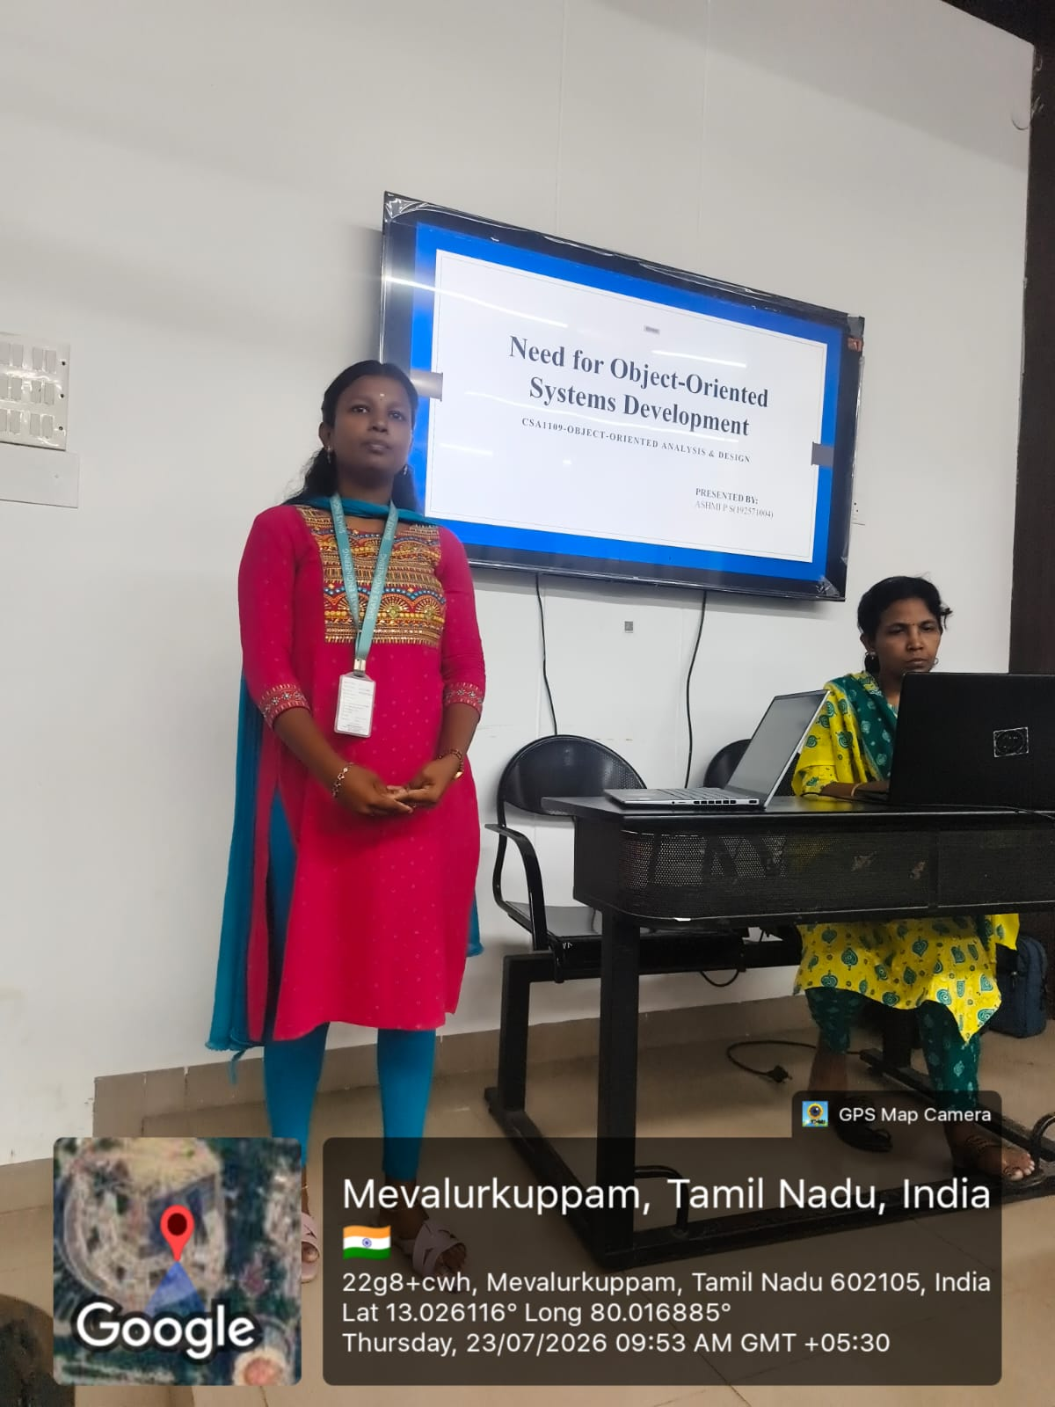
PRESENTATION SLIDE

